Slide 1
XPath
Waqar Yar

Slide 2
Xpath
XPath stands for XML Path Language
XPath uses "path like" syntax to identify and navigate nodes in an XML document
XPath contains over 200 built-in functions
XPath is a major element in the XSLT standard
XPath is a W3C recommendation

Slide 3
Xpath Functions
There are functions for string values, numeric values, booleans, date and time comparison, node manipulation, sequence manipulation, and much more.
Today XPath expressions can also be used in JavaScript, Java, XML Schema, PHP, Python, C and C++, and lots of other languages

Slide 4
Sample XML
<?xml version="1.0" encoding="UTF-8"?> <bookstore> <book> <title lang="en">Harry Potter</title> <price>29.99</price> </book> <book> <title lang="en">Learning XML</title> <price>39.95</price> </book> </bookstore>

Slide 5
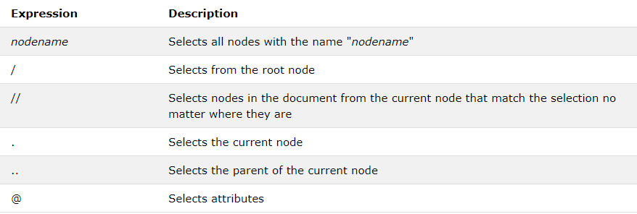
Selecting Nodes

Slide 6
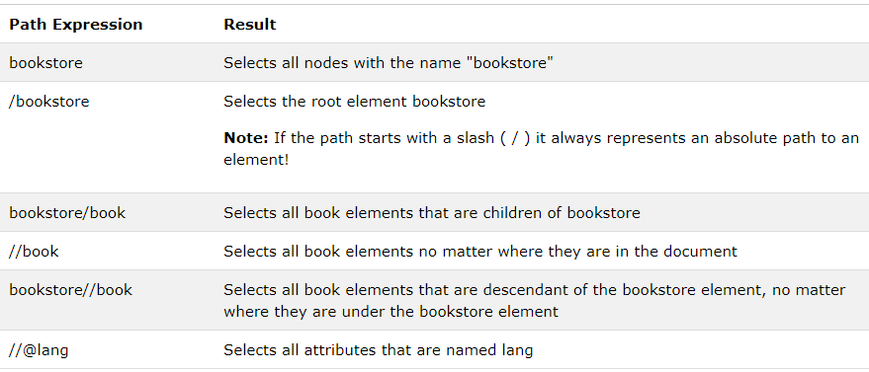
Selecting Nodes

Slide 7
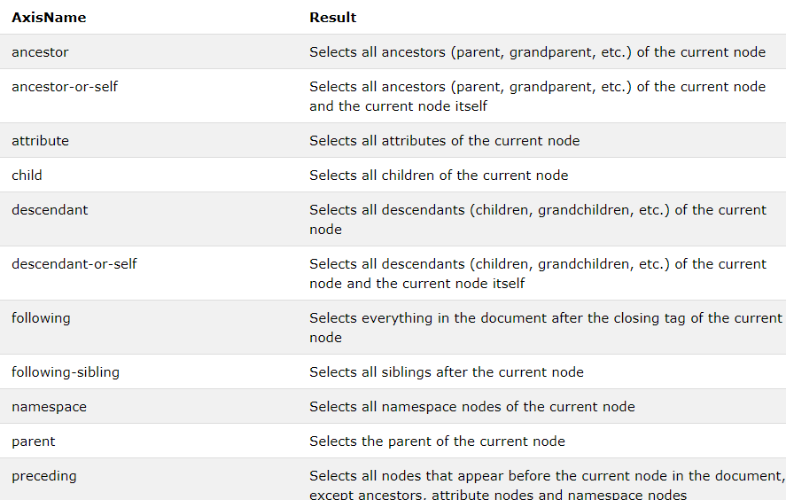
XPath Axes

Slide 8
Location Path Expression
A location path can be absolute or relative.
An absolute location path starts with a slash ( / ) and a relative location path does not. In both cases the location path consists of one or more steps, each separated by a slash:
An absolute location path: /step/step/... A relative location path: step/step/...

Slide 9
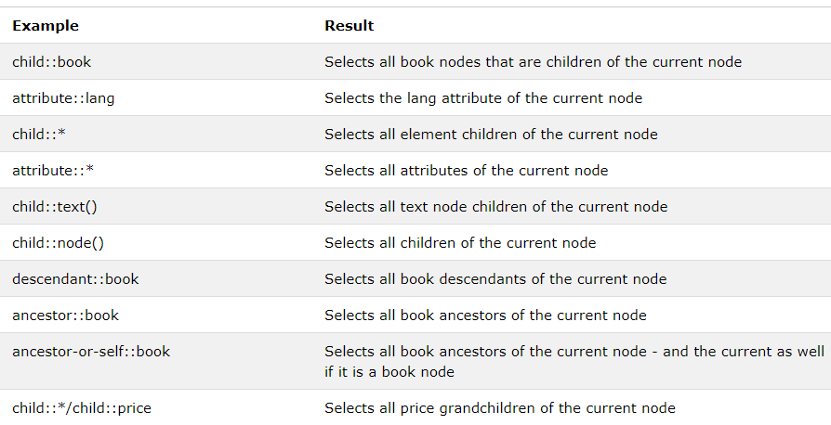
Location Path Examples

Slide 10
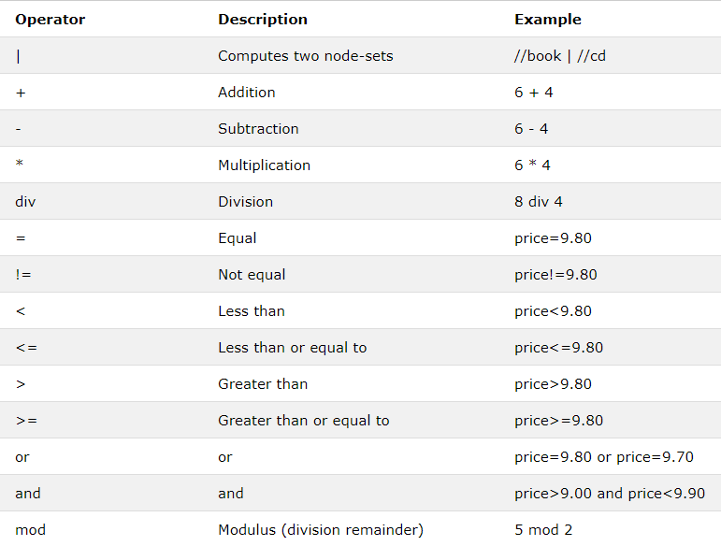
XPath Operators

